Slide 1
Transforming Healthcare:
Aligning Provider Culture
Mark Hernandez M.D.
Chief Medical Officer
Community Care Collaborative

Slide 2
Why Is An Aligned Provider Culture Important?
Providers play a key, direct role in the delivery of healthcare services to patients.
Providers’ services are a (or the) key revenue generator for their organizations.
Providers are considered “leaders” in the healthcare delivery system, by their organizations, their teams, their patients and themselves.

Slide 3
So What Are We Aligning Providers With?
Ongoing movement to a focus on the patient first (PCMH, expanded health management structures with patient’s needs driving the services)
Transformation of the payment model (Movement away from fee for service models and towards value based payment methodologies; accountable care organizations)
Transformation of the delivery models (Emphasis on integrated care delivery; integrated practice units)

Slide 4
How Are Providers The Same And Different?
Similarities
Differences
They want to feel that the work they do makes a difference
They are people, have same personal wants and needs as everyone else
They do not understand all of the complexity of healthcare delivery
They feel that they make an important, central role to healthcare delivery
They feel that they are highly invested in their work and the delivery system in general
They often believe that healthcare has been made needlessly complicated

Slide 5


Slide 6
Creating A Culture Of Change
No shortage of change treatises to help guide the process
John Kotter’s Leading Change
Chip & Dan Heath’s Switch: How To Change Things When Change Is Hard
One broad statement I would make here is that continuous and transparent communication is absolutely necessary in order to create an environment where culture change can take place
This is because the creation and maintenance of trust is key in alignment of culture

Slide 7
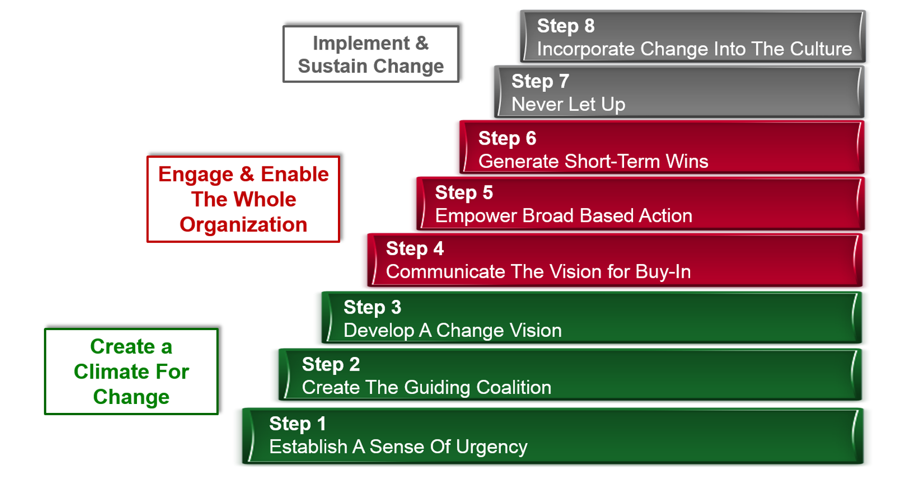
Kotter’s Leading Change Framework

Slide 8

The Heath’s Switch Framework

Slide 9


Slide 10
A Few Examples
Bedside Interdisciplinary Rounding- A Study In What Not To Do
Formalizing Cardiology Curbside Consults In Ambulatory Care- A Better Way To Engage

Slide 11

Questions?

